Slide 1

FAA Dataset – Plane collisions with wildlife
Gaurav Gujar

Slide 2
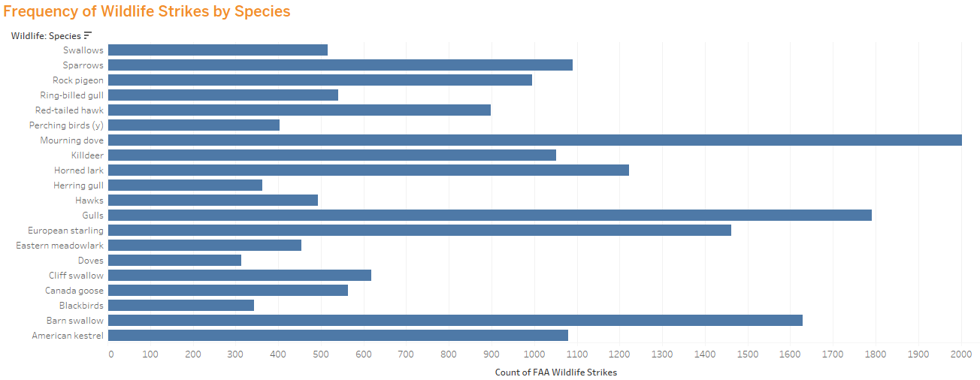

Slide 3
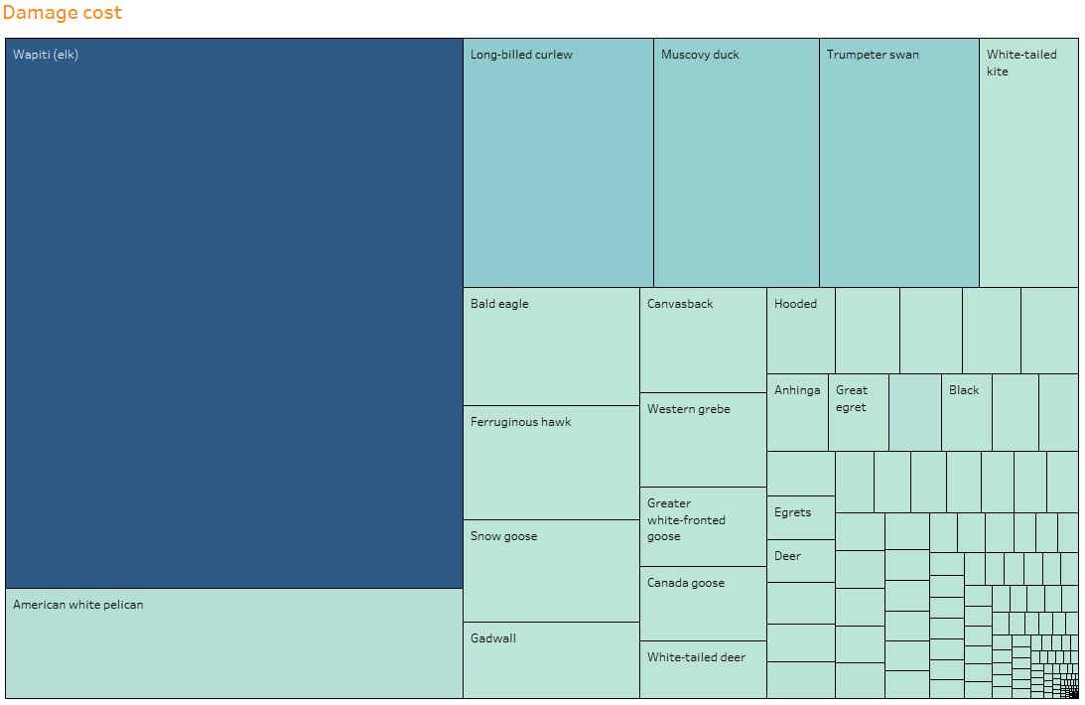
Damage Cost

Slide 4
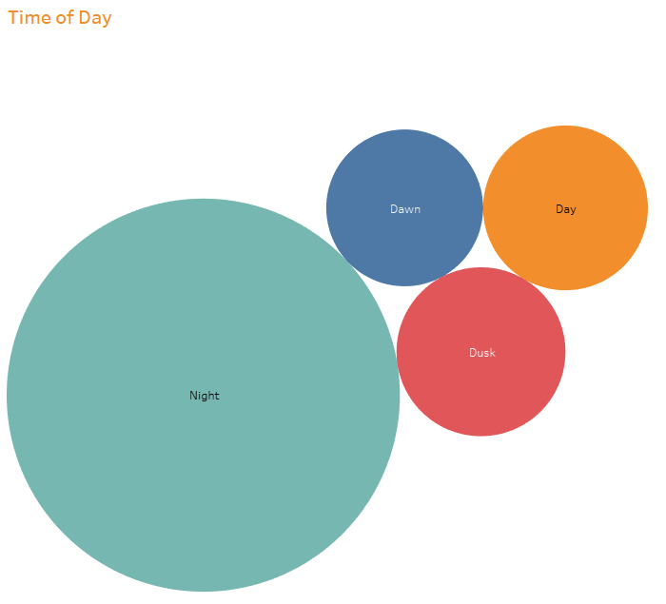

Slide 5
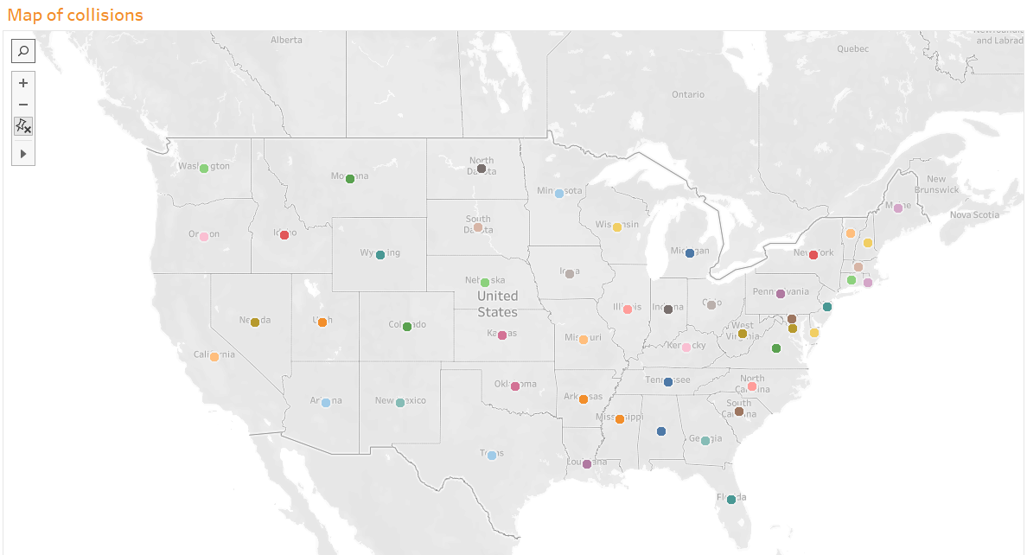

Slide 6
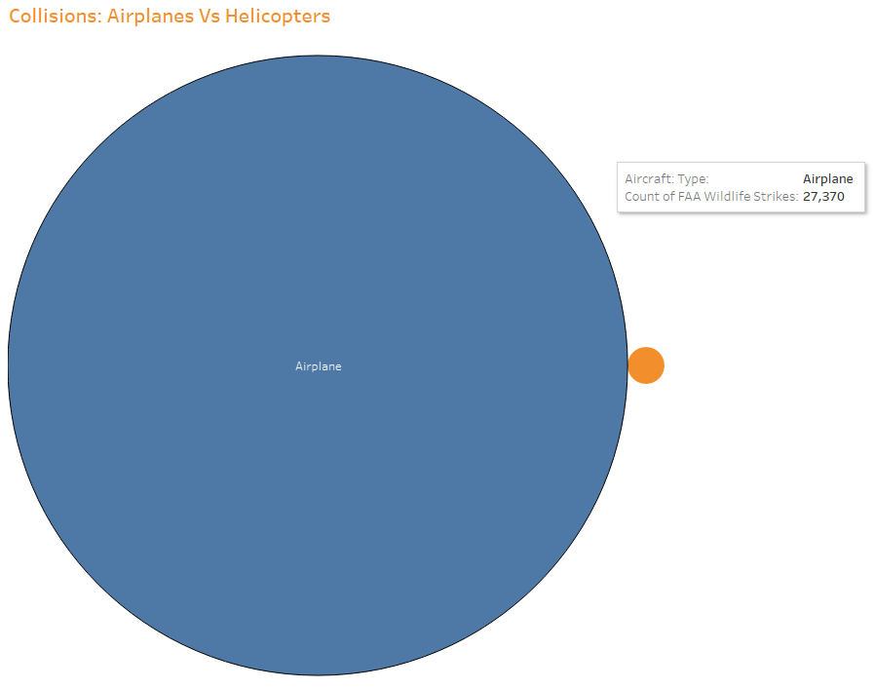

Slide 7
